Slide 1



Slide 2
System Test Engineer

Slide 3
What is a Car?
A car (or automobile) is a wheeled motor vehicle used for transportation.

Slide 4
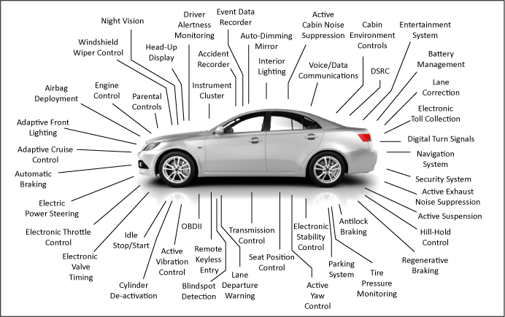
Functionalities of a car

Slide 5
What is an ECU?
An electronic control unit (ECU) is any embedded system in automotive electronics that controls one or more of the electrical systems or subsystems in a vehicle.

Slide 6
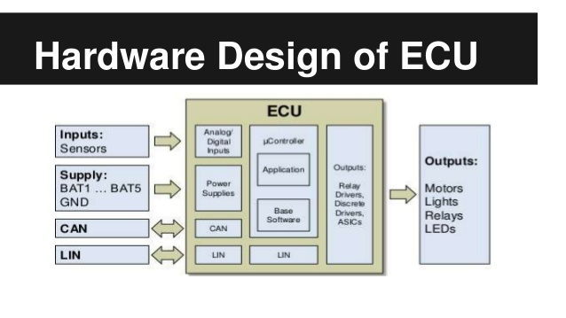
What is an ECU?
An electronic control unit (ECU) is any embedded system in automotive electronics that controls one or more of the electrical systems or subsystems in a vehicle.

Slide 7
Types of ECU
Door Control Unit
Engine Control Unit
Brake Control Unit
Airbag Control Unit
Battery Management System etc

Slide 8
Network Protocols
CAN
LIN
MOST
UDS
CAN FD
FlexRay
Automotive Ethernet

Slide 9
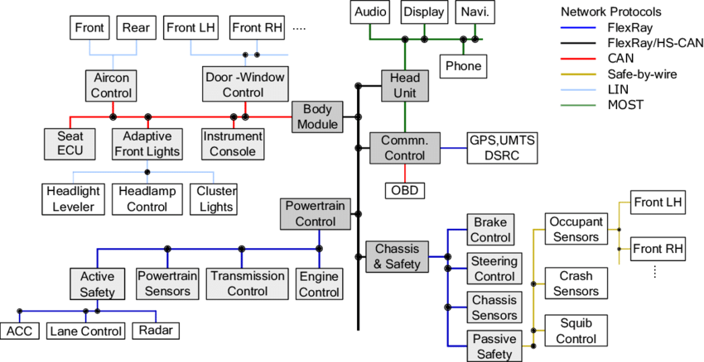
IN-Vehicle Architecture

Slide 10
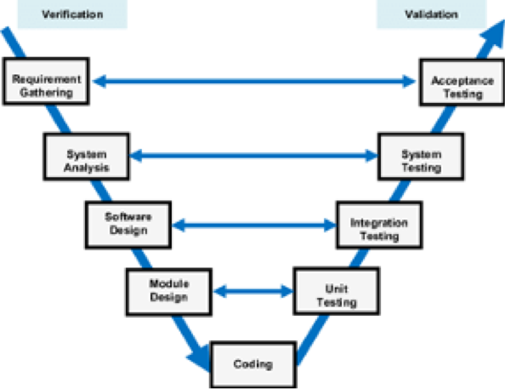
V Model- Software Development Lifecycle of an ECU
Course Focus

Slide 11
Need for Network Arbitration
A mordern car has around 70 ECUs
Some of the ECUs work independently, but all other need communications to be established between them
CAN is used to achieve this communication

Slide 12
CAN
CAN is a multi-master serial bus standard for connecting Electronic Control Units (ECUs) also known as nodes.
Two or more nodes are required on the CAN network to communicate.
The complexity of the node can range from a simple I/O device up to an embedded computer with a CAN interface and sophisticated software.
All nodes are connected to each other through a two wire bus. The wires are a twisted pair with a 120 Ω (nominal) characteristic impedance.

Slide 13
CAN BUS
CAN H
CAN L
CAN BUS
CAN
NODE 1
CAN
NODE 2
CAN
NODE 3

Slide 14
Mesh
2
1
4
3

Slide 15
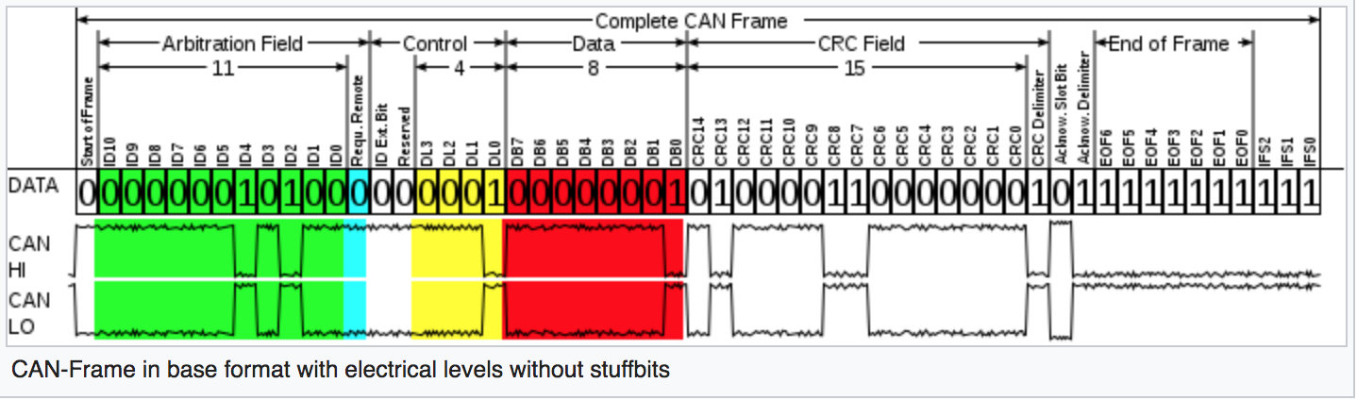
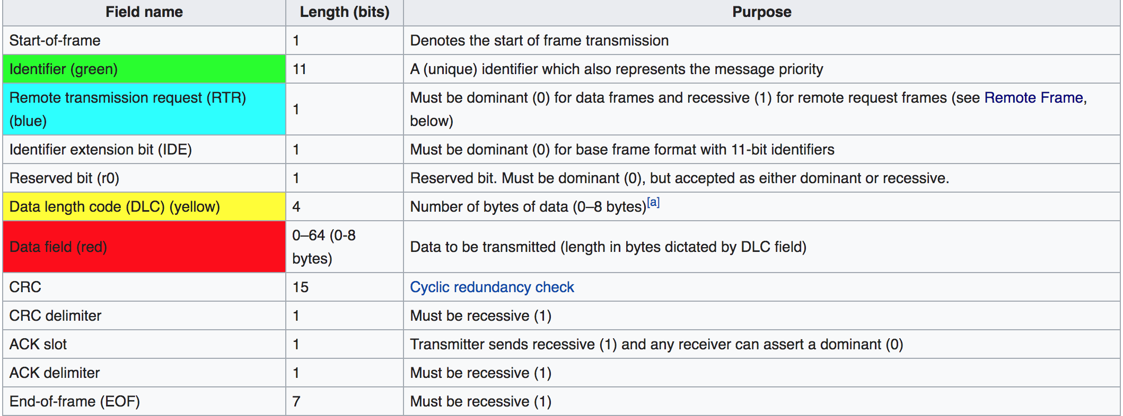
CAN Frame Format

Slide 16
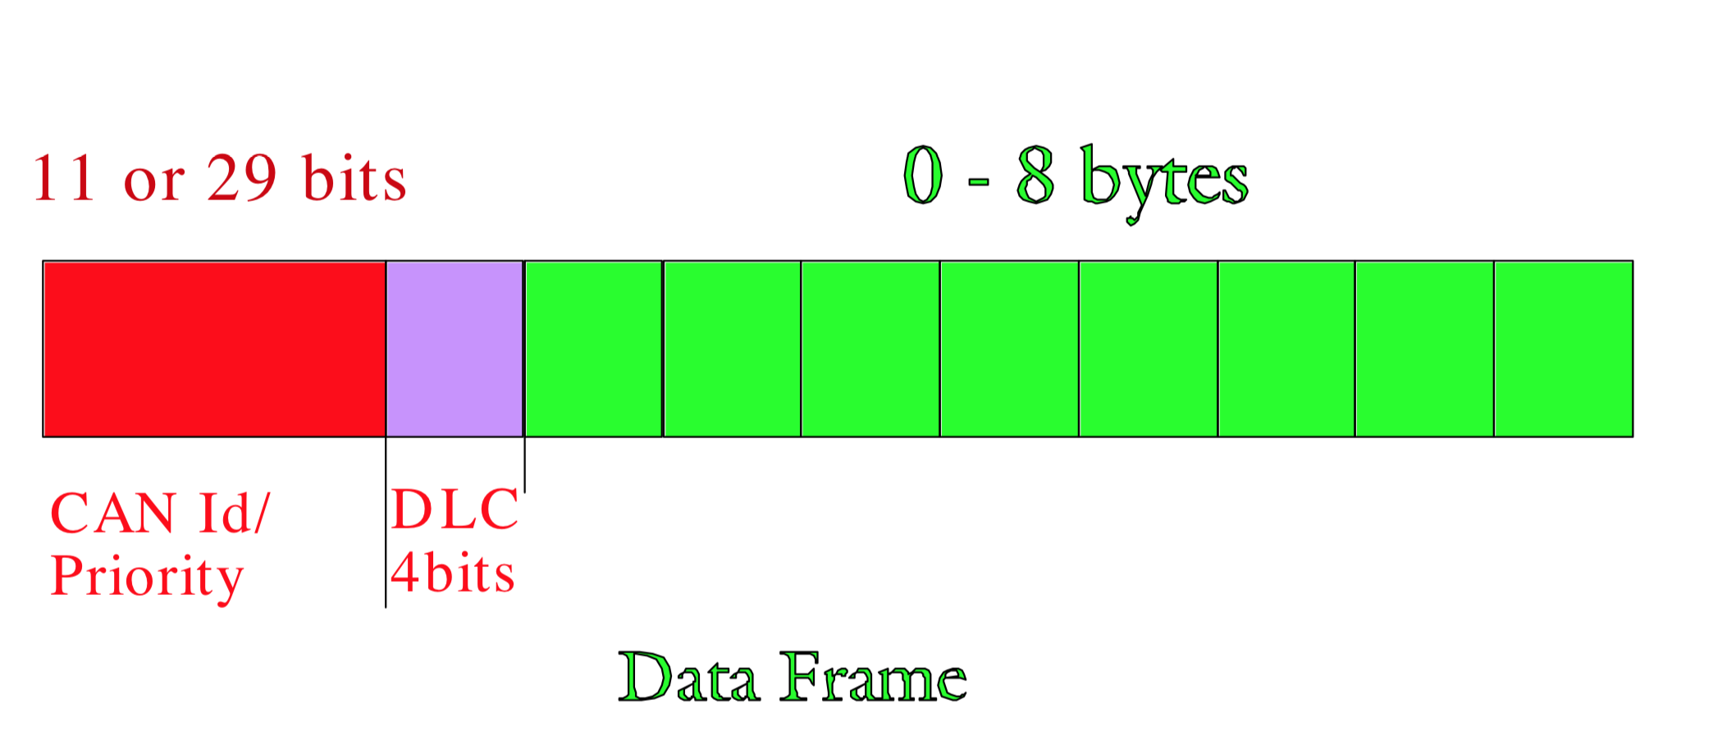
CAN Message frame

Slide 17
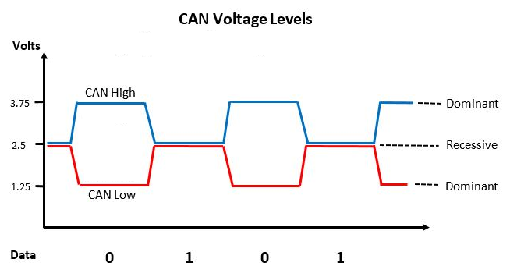
CAN HIGH and LOW
‘0’ is represented by (3.75V - 1.25V) = 2.5V
‘1’ is represented by = 0V

Slide 18
CAN
CAN Properties:
The bus can have one of two complimentary logical:
Dominant ‘0’
Recessive ‘1’
During the simultaneous transmission of ‘dominant’ and ‘recessive’
bits the resulting bus value will be ‘dominant’
CAN is a broadcast message protocol

Slide 19
CAN
BRAKE ECU ID ‘0101’
Window Panel ECU ID ‘1011’
If both the ECUs start transmitting simultaneously in the CAN bus then the BRAKE ECU will be selected. The window panel ECU will wait and retransmit.
This provides prioritisation and avoids collision

Slide 20
CAN H
CAN L
0010
CAN BUS
0101
1011
0010
CAN
Accelerator
CAN
Seat belt
ECU
CAN
Brake
CONTI
BOSCH
X

Slide 21
Types of CAN FRAMES
Data Frame
  99% of transmission
Remote Frame
Error Frame
  Every device/node calculates the CRC
  If any device finds a mistake; the EOF will be turned ‘dominant’.
  Every other device will throw the frame

Slide 22
Youtube link to install Linux
https://youtu.be/DC89AryJEE8

Slide 23
DAY 2
Initiatlizing Socket CAN
Sending and Receiving messages on Socket CAN
Number Systems
ECLIPSE INTRO
Python Intro
Strings
Integers

Slide 24
VCan/Socket CAN
Is a set of open source CAN drivers & a networking stack.
Traditional CAN drivers allowed only allow sending to and receiving from the CAN controller. Supported only a single process at a time. All other processes-blocked.
The Socket CAN allows multiple applications to access one CAN device simultaneously.
Also, a single application is able to access multiple CAN networks in parallel.
Communication with the CAN bus is done analogously to the use of the Internet Protocol via sockets.

Slide 25
CAN H
CAN L
VCAN0
0010
CAN
BRAKE
CAN
Window
CAN
CRASH
Sensor
Motor

Slide 26
VCan/Socket CAN
``shell
pip3 install python-can
pip3 install cantools
pip3 install can-isotp
pip3 install canmatrix
sudo modprobe vcan # setup vcan
sudo ip link add vcan0 type vcan # setp vcan0 as vcan
sudo ip link set up vcan0 #initializes the vcan0
cansend vcan0 001#1234567890AABBCC
Candump any # puts receiver in listening mode
cangen vcan0 # sends periodic
candump -help # for further help in can

Slide 27
Number Types
Binary, Decimal, Hexa
Binary – Base2 (0 ,1)
Decimal – Base10 (0,1,2,3,4,5,6,7,8,9)
Hexa - Base 16 (0,1,2,3,4,5,6,7,8,9,A,B,C,D,E,F)
We All understand DECIMAL. Number 231 is a decimal.
231 in binary ( 0 1 2 3 4 5 6 7 8 9)
231=128+64+32+4+2+1= 224
2⁸ 2⁷ 2⁶ 2⁵ 2⁴ 2³ 2² 2¹ 2⁰
256 128 64 32 16 8 4 2 1
1 1 1 0 0 1 1 1
^{Binary 0 1}

Slide 28
Number Types
HEXA —0 1 2 3 4 5 6 7 8 9 A B C D E F
c. 231 in hexa
16⁸ 16⁷ 16⁶ 16⁵ 16⁴ 16³ 16² 16¹ 16⁰
²⁵⁶ ¹⁶ ¹
^{E 7}
^{14x16 =224+}
^{7x1 = 7}
⁼ ²³¹

Slide 29
Number Types
Why do you have a 4 bit identifier
123#12 34 FF AA BB
THE COMPUTER WILL READ THE DATA AS
123# 0100100 00110100 11111111 10101010 10111011

Slide 30
Python Key words
and else
except break
False class
True continue
for def
from del
Global if
import elif
in or
Lambda while

Slide 31
CAN H
CAN L
VCAN0
001x 1234
CAN
Airbag
CAN
SEAT Belt
ECU
CAN
CRASH
ON EVENT
CRASH Sensor
ON EVENT
KEYBOARD
Motor

Slide 32
ECU Task- CAN
Send and Receive CAN Messages
ACTION- ON EVENT (crash detected value comes from sensor)- key press
ACTION- ON MESSAGE (value comes from other ECUs)

Slide 33
ECU – development team
DBC file and the requirement
Develop the ECU
Written a python code for ECU development
System testing Team
If this is code is correct – this code will be falshed into the hardware/ Microcontroller/ ECU

Slide 34
System Testing team
DBC file and the requirement
They will have Rahul;s python code. But they cant see the code.
Santhosh- They have to check if Rahusl code is correct/not?

Slide 35
Seat Belt ECU
Tester Node:
1. b- Send the “brake message=1”
Response= ‘seatbelt locked’
2. Send the accelerator message=0
Response= ‘seatbelt unlocked’
(DBC reference)
SEAT BELT ECU:
1. responds to brake message=1 ;
Lock the seat belt
2. Responds to an accelerator messag=0
Release the seatbelt
(Black Box)
CAN BUS

Slide 36
ENGINE ECU
Tester Node:
1. Send acceleration message
Response= ‘ Is speed increading by 10’
2. Send deacceleration message
Response= ‘ Is speed decreading by 10’
2. Send the brake message
Response= ‘Acceleration value=0’
(DBC reference)
Engine ECU:
1. Responds to acceleator message by
Increaing/decreasing speed
2. Responds to brake message by
bringing acceleration to ‘0’
(Black Box)
CAN BUS

Slide 37
Airbag ECU
Airbag ECU:
1. crash detected, engine is running,
setabelt worn –
airbag will be released
2. crash detected, engine is not running/
Seatbelt not worn – sirbag is not ready
3. when no crash is detected- engine is running,
Seatbelt is worn- airbag is ready
Tester Node:
1. vehicle motion message – engine running/
crash detected, seatbelt msg,
Check
a.airbag released
b. airbag not ready
c. airbag is ready
CAN BUS

Slide 38
Engine ECU
BUS
Trace
Display

Slide 39
ECU Block
Engine ECU
Opens your ECU SIMX
Configure ECU
Simx
Save and
close
the
file
Store the
python/capl/cpp script
linked with teh ECU

Slide 40
BUS
BUS
Config the bus- CAN/
VCAN/Ardino/STM
Socket CAN/Extended
CAN
SAve
Check if the bus config is available in ECU SIMX

Slide 41
Trace Window
Trace
Blank Screen
Choose the bus /
Candump any
Can Dump
Display all the
messages
Check if the bus config is available in ECU SIMX
PYQT 5
Challenge- Needs to integrate the qml file.

Slide 42
Display Window
Trace
Display
Set the ID
Display the value
from the trace
In GUI
If accepted
During compiling it will check
and accept

